Slide 1
Topic Hierarchy Construction for the Organization of Multi-Source User Generated Contents
Date : 2013/09/17
Source : SIGIR’13
Authors : Zhu, Xingwei
Ming Zhao-Yan
Zhu, Xiaoyan
Chua, Tat-Seng
Advisor : Dr.Jia-ling, Koh
Speaker : Wei, Chang

Slide 2
Outline
Introduction
Approach
Experiment
Conclusion

Slide 3
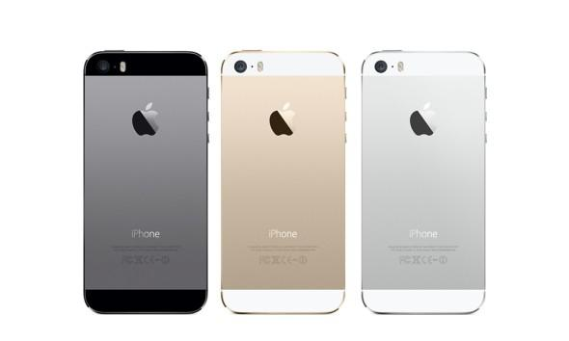
IPhone 5s? IPhone 5c?

Slide 4
Multi-Source User Generated Contents

Slide 5
Problem Formulation
Goal : Given a root topic C and its information source set Sc, we aim to build and continuously update a topic hierarchy H for C in order to organize the information in Sc according to their relevant topics.
In this paper, Sc={Blogger, Twitter, community QA site(cQA)}

Slide 6
Outline
Introduction
Approach
Framework
Topic Term Identification
Topic Relation Identification
Topic Hierarchy Generation
Topic Hierarchy Update
Experiment
Conclusion

Slide 7
Framwork

Slide 8
Topic Term Identification
User Generated Contents
Potential Grounding Topics
Heuristic Rules
Grounding Topic Set
TF-IDF
Final Candidate Topic Set
External Sources

Slide 9
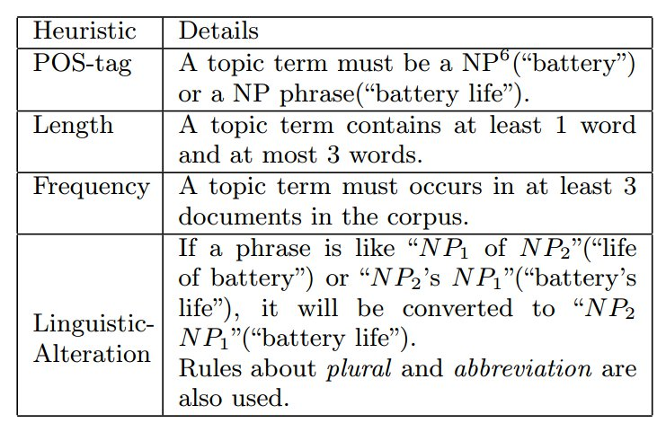
Heuristic Rules

Slide 10
Grounding Topic Set
TFIDF
IPhone
Blog 1
IPhone
Apple Inc.
Apple Inc.
QA 1
T-Mobile
Apple Inc.
T-Mobile
Apple
IOS
IPhone
Smartphone
QA 2
IOS
Apple Inc.
64-bit
Tweet 1
IOS
Price
Tweet 2
IPhone
IOS

Slide 11
Grounding Topic Set
Blogs
Use the content and title
Double weights of terms in titles
Use the top 5 terms
cQAs :
Use the question title, description and the best answers
Use the top 5 terms
Tweets :
Use the content
Use the top 1 terms

Slide 12
Topic Set Extension
What we already have :
Grounding topic set $T_{G}=\{t_{g1},t_{g2},…\}$
What it lacks :
Middle level topic
How to get middle level topics :
Search Engine : 2 patterns
* such as <slot>
<slot> of *
WordNet : direct hypernym
Wikipedia : category tags
Final candidate topic set : $T=\{C\}∪T_{G}∪$ $T_{G}$

Slide 13
Outline
Introduction
Approach
Framework
Topic Term Identification
Topic Relation Identification
Topic Hierarchy Generation
Topic Hierarchy Update
Experiment
Conclusion

Slide 14
Topic Relation Identification
Apple Inc.
$$e(r(t_{A},t_{B}))$$
$$e(r(t_{B},t_{A}))$$
$$e(r(t_{A},t_{C}))$$
$$e(r(t_{C},t_{A}))$$
$$e(r(t_{C},t_{B}))$$
IPhone
IPhone 5s
$$e(r(t_{B},t_{C}))$$
Denote $r\left(t_{A},t_{B}\right)$ as a sub-topic relation, which means $t_{B}$ is a sub-topic of $t_{A}$

Slide 15
Topic Relation Identification

Slide 16
Evidences from the Information Source Set
$e_{{distr}_{doc}}(t_{A},t_{B})$, $e_{{distr}_{sen}}(t_{A},t_{B})$ : the cosine similarity between the corresponding contexts of them
V=(smart phone, price, buy, iOS, Android)
$t_{A}=Apple Inc$
$t_{B}=T−Mobile$
$v_{t_{A}}=(3, 5, 10, 2, 3)$
$v_{t_{B}}=(2, 4, 11, 1, 3)$
$e_{{distr}_{doc}}\left(t_{A},t_{B}\right)=\frac{<v_{t_{A}},v_{t_{B}}>}{\left\|v_{t_{A}}\right\|\left\|v_{t_{B}}\right\|}$

Slide 17
Evidences from Wikipedia
Pointwise Mutual Information (PMI)

Slide 18
Evidences from WordNet

Slide 19
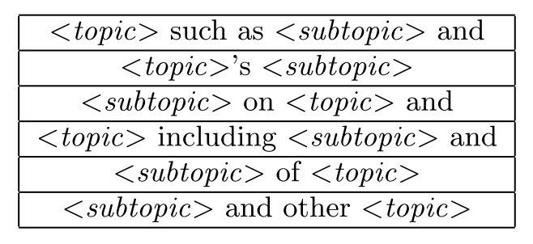
Evidences from Search Engine Results
Pattern-based evidences
Query = “tA such as tB and” root topic
$e_{{spattern}_{i}}(t_{A},t_{B})$ = 1 if the search engine returns more than ζ results that contain this query; otherwise it is set to 0.

Slide 20
Combine Evidences

Slide 21
Outline
Introduction
Approach
Framework
Topic Term Identification
Topic Relation Identification
Topic Hierarchy Generation
Topic Hierarchy Update
Experiment
Conclusion

Slide 22
Topic Hierarchy Generation

Slide 23
Topic Hierarchy Generation

Slide 24
Topic Hierarchy Generation

Slide 25
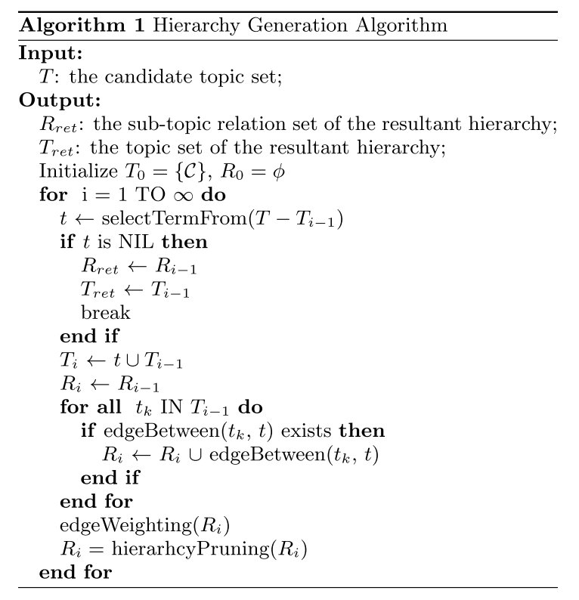
Topic Hierarchy Generation

Slide 26
Edge Weighting

Slide 27
Hierarchy Pruning
Use the Chu- Liu/Edmond’s optimum branching algorithm
every non-root node has only one parent and the sum of the edge weights are maximized
remove
(1) the nodes that are not reachable for the root topic and
(2) the leaf nodes that are not in the grounding topic set.

Slide 28
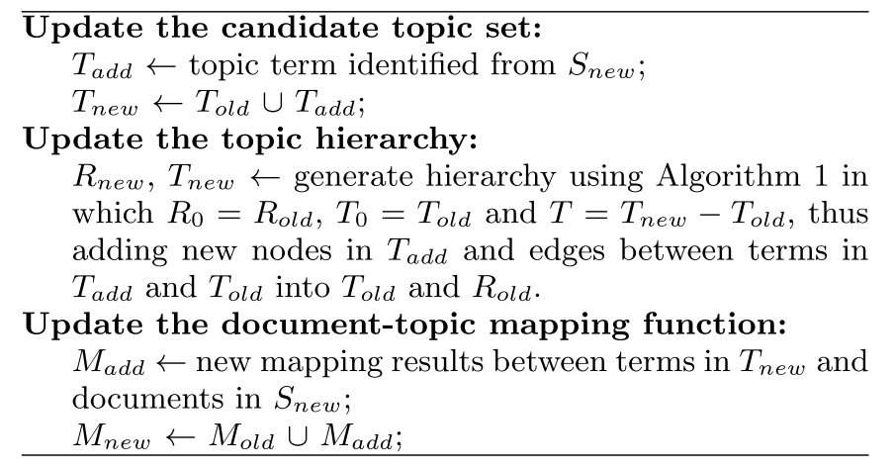
Topic Hierarchy Update

Slide 29
Outline
Introduction
Approach
Framework
Topic Term Identification
Topic Relation Identification
Topic Hierarchy Generation
Topic Hierarchy Update
Experiment
Conclusion

Slide 30
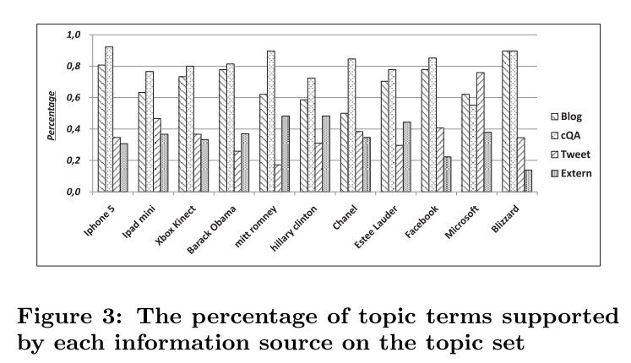
Topic Term Identification

Slide 31
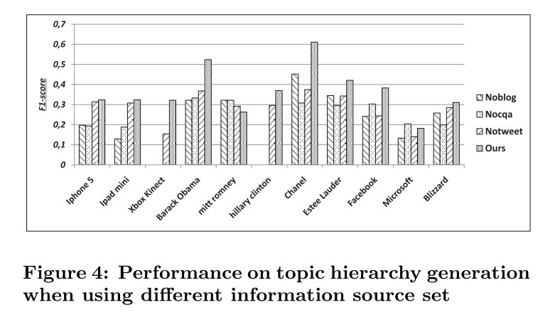
Topic Hierarchy Generation

Slide 32
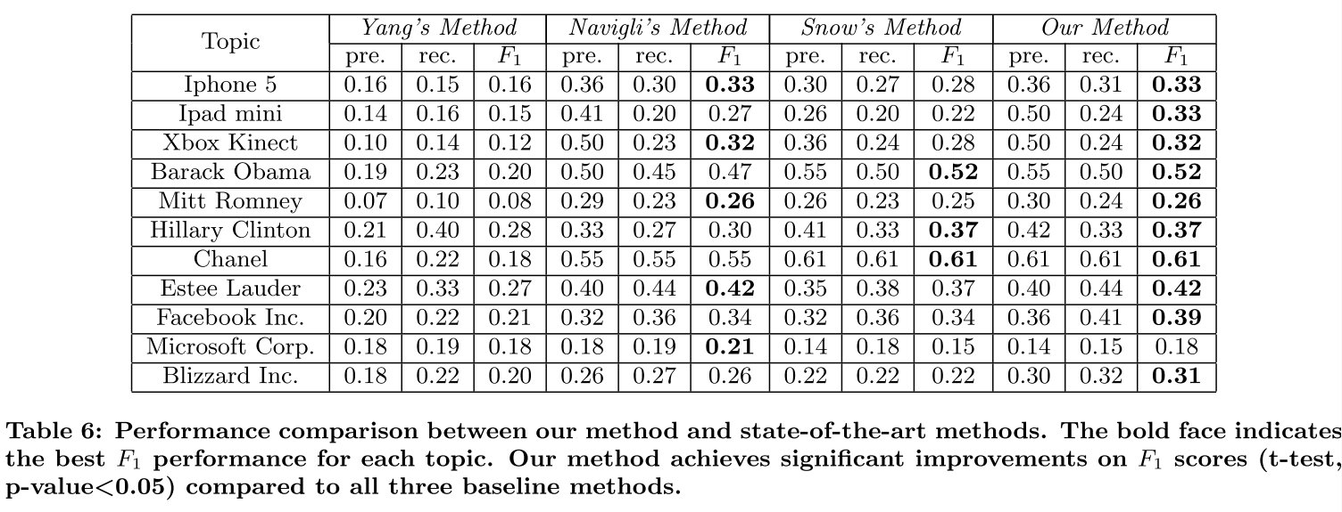
Topic Hierarchy Generation

Slide 33
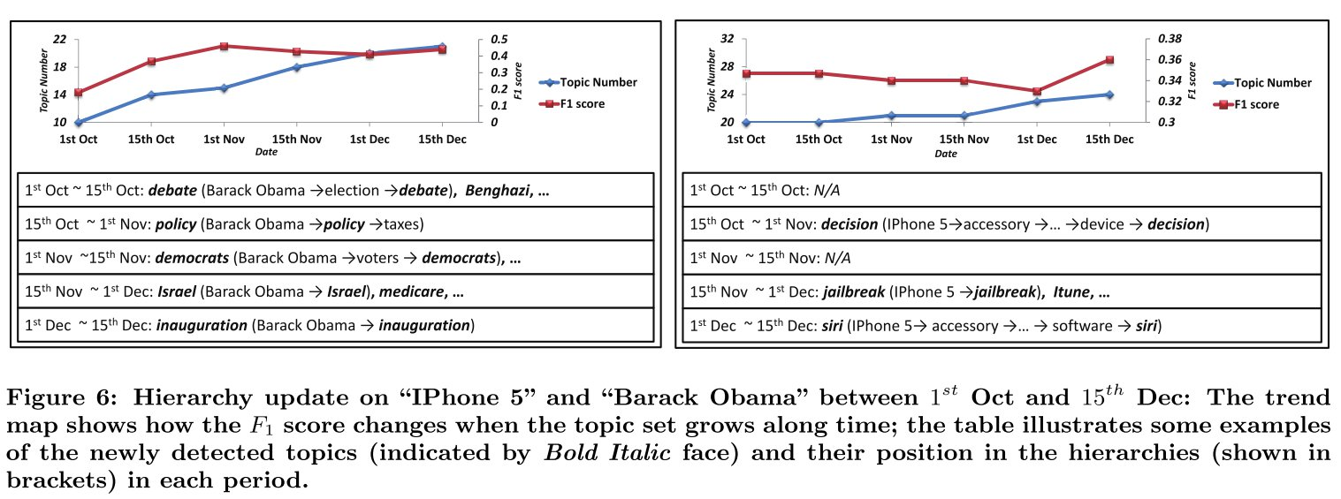
Hierarchy Update

Slide 34
Outline
Introduction
Approach
Framework
Topic Term Identification
Topic Relation Identification
Topic Hierarchy Generation
Topic Hierarchy Update
Experiment
Conclusion

Slide 35
Conclusion
Given a root topic, we used evidences from multiple UGCs to identify topic terms and sub-topic relations between them. With these topic terms, a graph-based algorithm was applied to generate and update the topic hierarchies, on which the UGCs can be organized according to their relevant topics.

